Slide 1
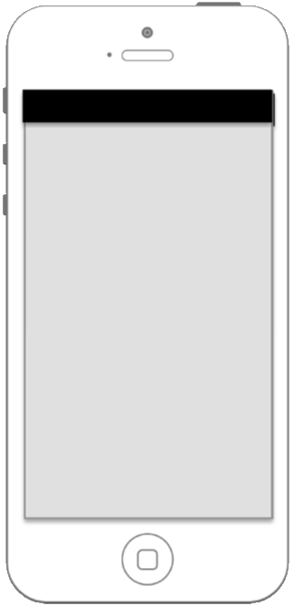


Quiz state
Basic needs
Supporting needs
Surroundings state
Disaster specific information
Extra information

Slide 2
Anwser questionnary
Quiz state
Map statistics
Basic needs
Disaster Survival tips
Supporting needs
Environrment state
Disaster specific information
Extra information

Slide 3



Information
Earthquake
Tsunami
Terrorist attack

Slide 4
Survive
Earthquake
Someone is injured
Someone is stuck
Someone needs urgent help
Level of buildings destruction:
Select
I (we) can survive alone for:
3-4 days
Less than one day
1-2 days
3-4 days
More than 4 days
Send

Slide 5
Survive
Tsunami
Someone is injured
Someone is stuck
Someone needs urgent help
Level of buildings destruction:
Select
I (we) can survive alone for:
Select
Level of water:
Select
Send

Slide 6
Survive
Tsunami
Someone is injured
Someone is stuck
Someone needs urgent help
Level of buildings destruction:
Select
I (we) can survive alone for:
Select
Level of water:
3-5 meters
None
1-3 meters
3-5 meters
More than 5 meters

Slide 7
Survive
Terrorist attack
Someone is injured
Someone is stuck
Someone needs urgent help
Someone is still in danger
Level of buildings destruction:
Select
Send

